Slide 1
CSS 422 Hardware and Computer Organization
ARM Branch and Control Instructions
Ver. 3
Professor: Munehiro Fukuda

Slide 2
Topics
Conditional execution
Branch instructions and condition code
Function call and return
Single-flag, unsigned/signed conditional branches
How to translate C/C++ code into ARM code
if-else
for loop
do/while
switch
recursion
argument passing
IT block, MSR/MRS instructions

Slide 3
Conditional Execution
Programming constructs in high-level languages
if-else, for-loop, while-loop, and switch-cases
A function call and the return
Exceptions/Interrupts and their returns
Device Interrupts, (e.g., timer, DMA, etc.)
Software exceptions, (a.k.a., system calls)
Hardware faults, (e.g., seg faults, zero division, etc.)
Stopping CPU
ARM/Cortex-M has no “HALT” or “STOP”. Instead, we have to use: label B label

Slide 4
Branch
Instructions | Descriptions | Encoding | Offset ranges | Examples
B{cond} label | Branch to label. if ConditionPassed() then WritePC(PC + imm32); | 16 or 32bits | -256 to 255 (outside IT block) * -2KB to +2KB (inside IT block) -1MB to +1MB (outside IT block) -16MB to +16MB (inside IT block) | stop B stop ; infinite loop @stop ; this is how to stop ; Cortex-M
BX{cond} Rm | Branch indirect to the address specified by Rm. if ConditionPassed() then WritePC(Rm); | 16bits | Any arbitrary value in the register | BX LR ; return from function
BL{cond} label | Branch with link to label while saving BL’s next address in LR (R14) for a return purpose. if ConditionPassed() then next_instr_addr = PC; LR = next_instr_addr<31:1> : ’1’; WritePC(PC + imm32); | 32bits | -16MB to +16MB | BL funcion ; function call
BLX{cond} Rm | Branch indirect with link to the address specified by Rm while saving BL’s next address in LR (R14) for a return purpose. if ConditionPassed() then next_instr_addr = PC - 2; # LR = next_instr_addr<31:1> : ’1’; WritePC(Rm); | 16bits | Any arbitrary value in the register | LDR R3, =funcion BLX R3 ; function call via R3
* IT block is explained in slide pX.
# based on, https://developer.arm.com/documentation/ddi0308/d/Thumb-Instructions/Alphabetical-list-of-Thumb-instructions/BLX--register-

Slide 5
Condition Code

Slide 6
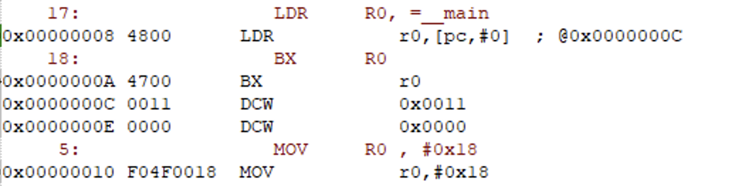
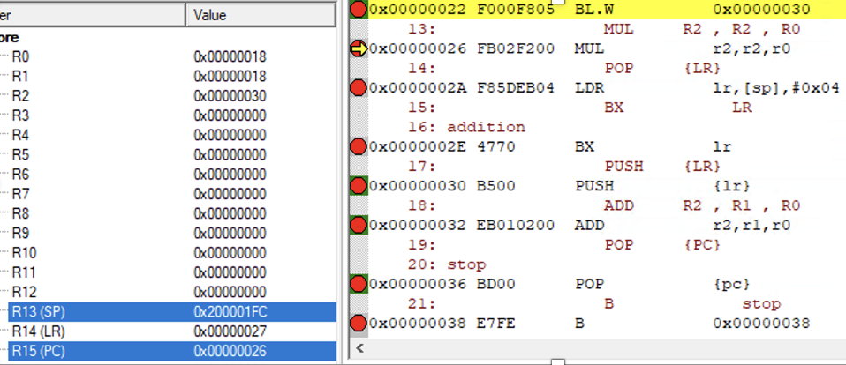
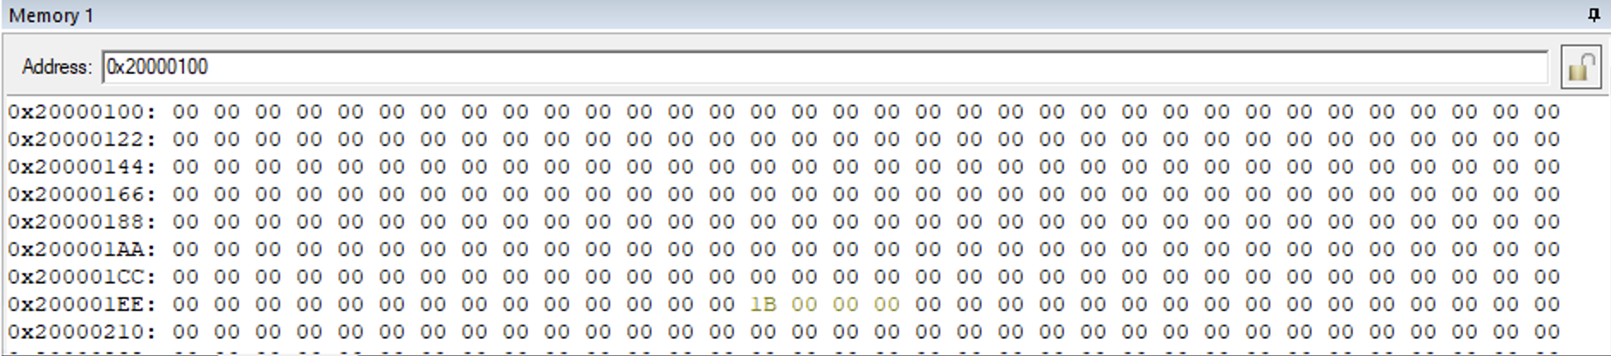
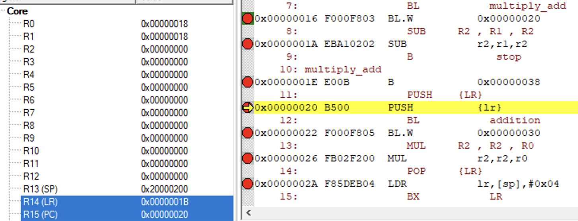
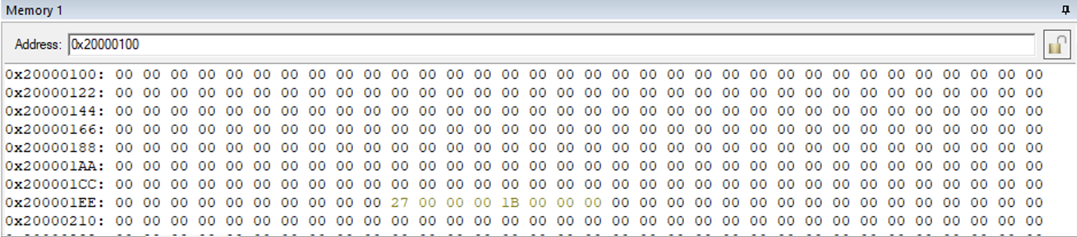
Function Call
startup_TM4C123.s
main.s
Stack_Size EQU 0x00000200
AREA STACK, NOINIT, READWRITE, ALIGN=3
Stack_Mem SPACE Stack_Size
__initial_sp
AREA RESET, DATA, READONLY
EXPORT __Vectors
__Vectors DCD __initial_sp ; Top of Stack
DCD Reset_Handler ; Reset Handler
AREA |.text|, CODE, READONLY
Reset_Handler PROC
EXPORT Reset_Handler [WEAK]
IMPORT __main
LDR R0, =__main
BX R0
END
AREAMYCODE , CODE , READONLY
EXPORT __main ; the first instruction to call
ENTRY
__main
MOV R0 , #0x18
MOV R1 , R0
BL multiply_add ; Branch to ‘multiply_add’
SUB R2 , R1 , R2
B stop
multiply_add
PUSH {LR} ; First preserve the return address
BL addition ; Call another function
MUL R2 , R2 , R0
POP {LR} ; Retrieve return address from stack
BX LR
addition
PUSH {LR}
ADD R2 , R1 , R0 ; R2 = R1 + R0
POP {PC}
stop
B stop
END
(3)
(4)
(1)
(5)
(2)
(6)
(2)
(1)
(6)
(3)
(4)
(6)
(3)
1B = 1A + 1
(5)

Slide 7
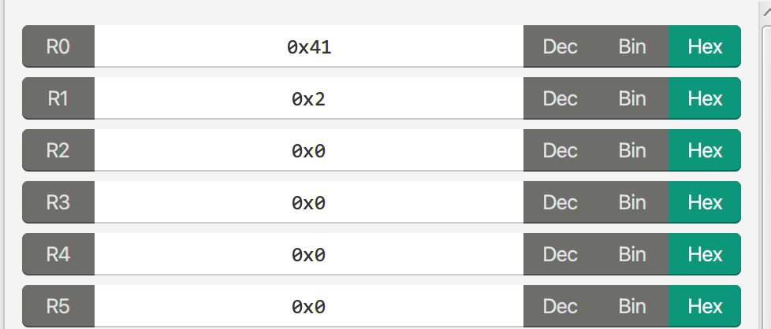
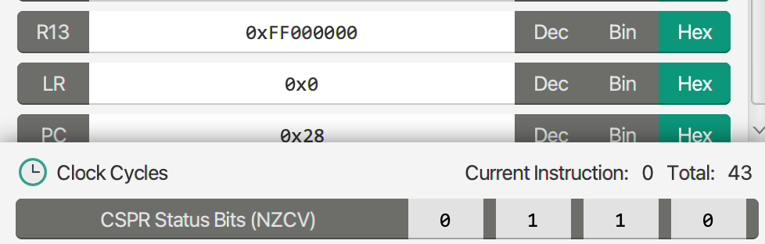
Single-Flag Branches
Z-Flag Usage
C-Flag Usage
C/C++ Code:
x = 10; // Variable initial value
loop:
x = x - 2;
if(x != 0) // Test the condition
goto loop;
ARM Code:
MOV R3 , #10
loop
SUBS R3 , R3 , #2
BNE loop
MOV R0, #'A' ; An ASCII Char
MOV R5, #7 ; loop counts
loop
RORS R0, R0, #1
ADDCS R1, R1, #1
SUBS R5, R5, #1
BNE loop
ROR R0, R0, #25
END ; R0 = the original ASCII, R1 = the number of 1s
...

Slide 8
Unsigned Conditional Branches
Instructions | Descriptions | Flags | Examples
BLO label | Branch to label if unsigned less than, ‘<‘ (same as BCC) | C==0 | LDR R0, =#0x7FFF LDR R1, =#0x8000 CMP R0, R1 BLO next ; go to next in this example
BHS label | Branch to label if unsigned greater than or equal to, ‘>=’ (same as BCS) | C==1 | LDR R0, =#0x7FFF LDR R1, =#0x8000 CMP R0, R1 BLO next ; no branch in this example
BLS label | Branch to label if unsigned less than or equal to, ‘<=’ | C==0 or Z==1 | LDR R0, =#0x7FFF LDR R1, =#0x8000 CMP R0, R1 BLO next ; go to next in this example
BHI label | Branch to label if unsigned greater than, ‘>’ | C==1 and Z==0 | LDR R0, =#0x7FFF LDR R1, =#0x8000 CMP R0, R1 BLO next ; no branch in this example

Slide 9
Signed Conditional Branches
Instructions | Descriptions | Flags | Examples
BLT label | Branch to label if signed less than, ‘<‘ | N != V | LDR R0, =#0x7FFF (a positive value) LDR R1, =#0x8000 (a negative value) CMP R0, R1 BLT next ; no branch in this example
BGE label | Branch to label if greater than or equal to, ‘>=’ | N = V | LDR R0, =#0x7FFF LDR R1, =#0x8000 CMP R0, R1 BGE next ; go to next in this example
BGT label | Branch to label if greater than, ‘>’ | Z = 0 and N = V | LDR R0, =#0x7FFF LDR R1, =#0x8000 CMP R0, R1 BGT next ; go to next in this example
BLE label | Branch to label if signed less than or equal to, ‘<=’ | Z = 1 and N != V | LDR R0, =#0x7FFF LDR R1, =#0x8000 CMP R0, R1 BLE next ; no branch in this example

Slide 10
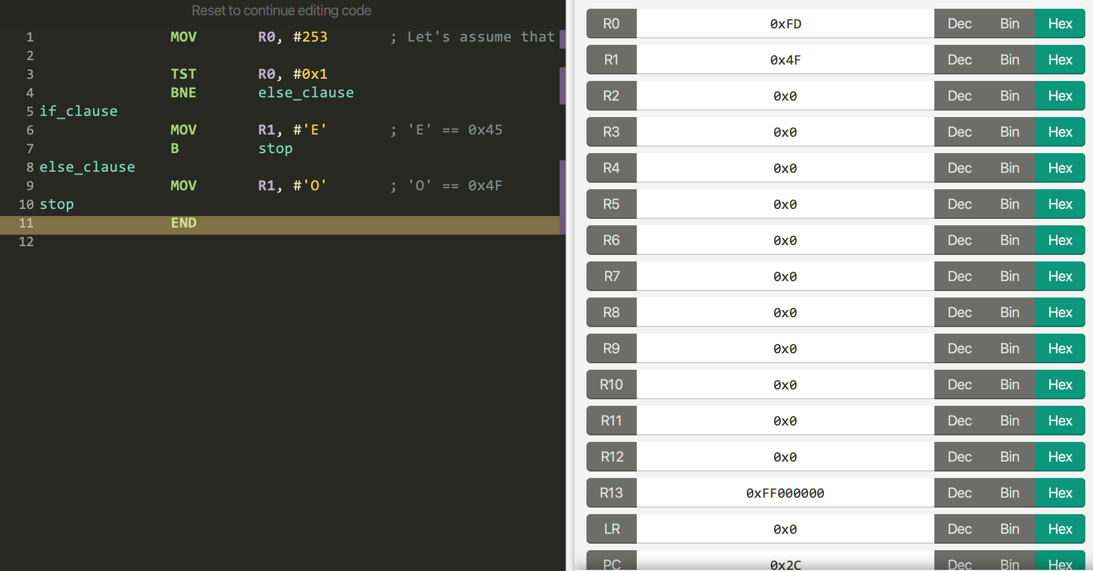
“if-else” Example
C/C++ Code:
if ( R0 > R1 )
do_something( );
else
do_something_else( );
ARM Code:
MOV R0, #253 ; Let's assume that R0 == 0xFD
TST R0, #0x1
BNE else_clause
if_clause
MOV R1, #'E' ; 'E' == 0x45
B stop
else_clause
MOV R1, #'O' ; 'O' == 0x4F
stop
END

Slide 11
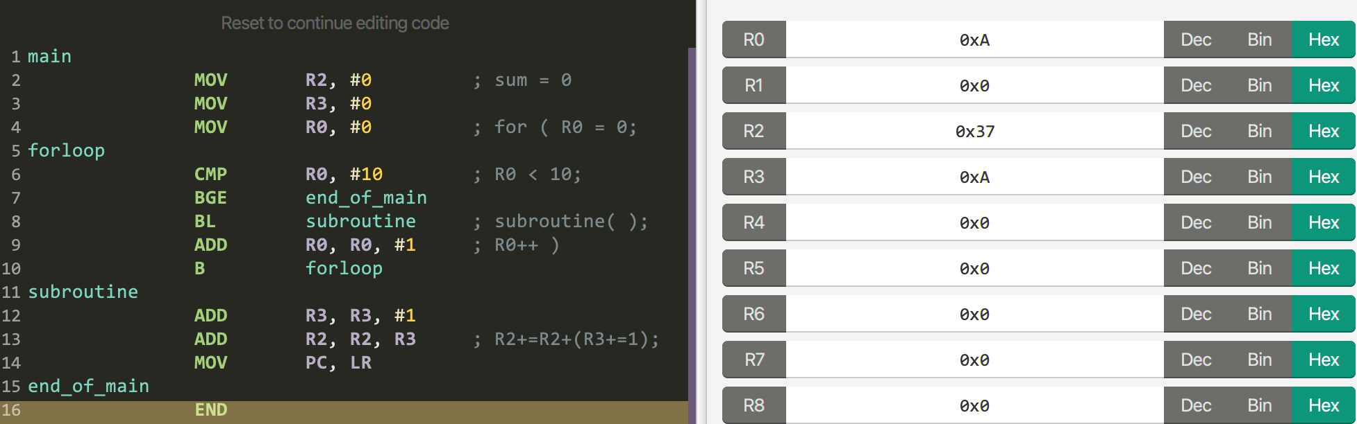
“for” Loop Example
C/C++ code:
void subroutine( ) {
static int sum = 1;
sum += sum + 1;
}
int main( ) {
for ( int counter = 0; counter < 10; counter++ ) {
subroutine( );
}
}
ARM Code:
main
MOV R2, #0 ; sum = 0
MOV R3, #0
MOV R0, #0 ; for ( R0 = 0;
forloop
CMP R0, #10 ; R0 < 10;
BGE end_of_main
BL subroutine ; subroutine( );
ADD R0, R0, #1 ; R0++ )
B forloop
subroutine
ADD R3, R3, #1
ADD R2, R2, R3 ; R2+=R2+(R3+=1);
MOV PC, LR
end_of_main
END

Slide 12
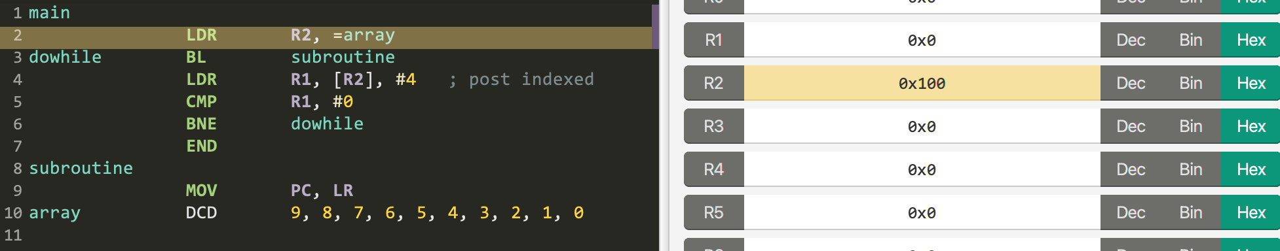
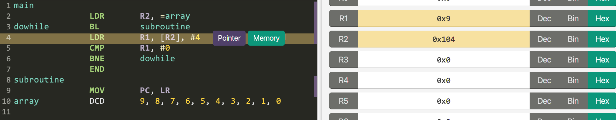
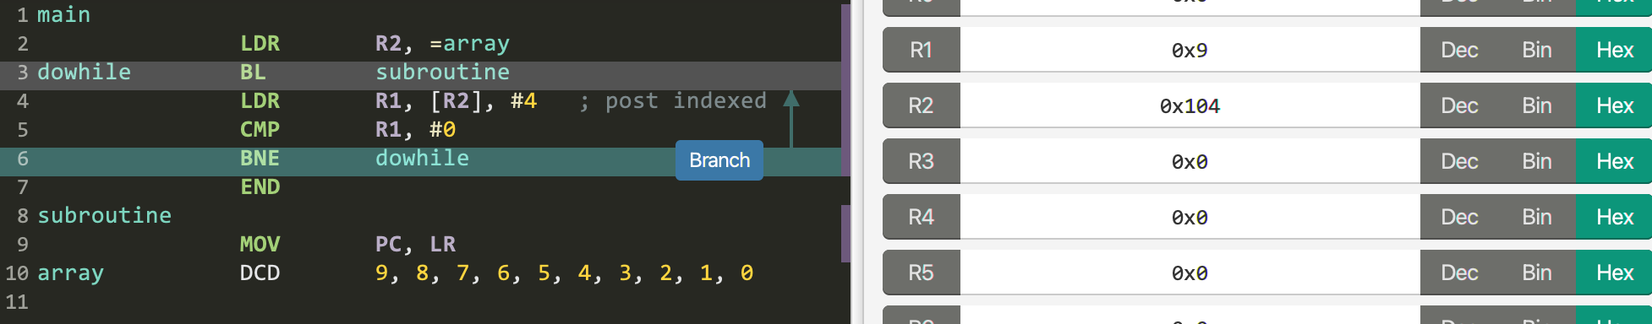
“do/while” Loop Example
C/C++ Code:
int main( ) {
int array[] = {9, 8, 7, 6, 5, 4, 3, 2, 1, 0};
int *a2 = array;
do {
subroutine( );
} while ( *( a2++ ) != 0 );
}
ARM Code:
main
LDR R2, =array
dowhile BL subroutine
LDR R1, [R2], #4 ; post indexed
CMP R1, #0
BNE dowhile
END
subroutine
MOV PC, LR
array DCD 9, 8, 7, 6, 5, 4, 3, 2, 1, 0

Slide 13
Switch case
C/C++ Code:
switch (x){ // Switch construct with three cases
case ‘ <0’ :
y = -1;
case ‘==0 ’ :
y = 0;
case ‘ >0’ : // Note there is no default case
y = 1;
}
ARM Code:
CMP R0 , #0
BLT negative
BEQ zero
BGT positive
negative
MOV R1 , -1
B stop
zero
MOV R1 , 0
B stop
positive
MOV R1 , 1
stop
B stop
The condition testing can be performed for multiple possible values, resulting in multi-way branching, (i.e., switch-cases statement)

Slide 14
CBZ/CBNZ Instructions
Instructions | Descriptions | Encoding | Flags
CBZ | Compare and branch if zero | 16 bits | N/A
CBNZ | Compare and branch if not zero | 16 bits | N/A
Revisiting the “do/while” example
C/C++ Code:
int main( ) {
int array[] = {9, 8, 7, 6, 5, 4, 3, 2, 1, 0};
int *a2 = array;
do {
subroutine( );
} while ( *( a2++ ) != 0 );
}
ARM Code:
main
LDR R2, =array
dowhile BL subroutine
LDR R1, [R2], #4 ; post indexed
CMP R1, #0
BNE dowhile
END
subroutine
MOV PC, LR
array DCD 9, 8, 7, 6, 5, 4, 3, 2, 1, 0
CBNZ R1, dowhile
Note: VisUAL does not support CBZ/CBNZ.

Slide 15
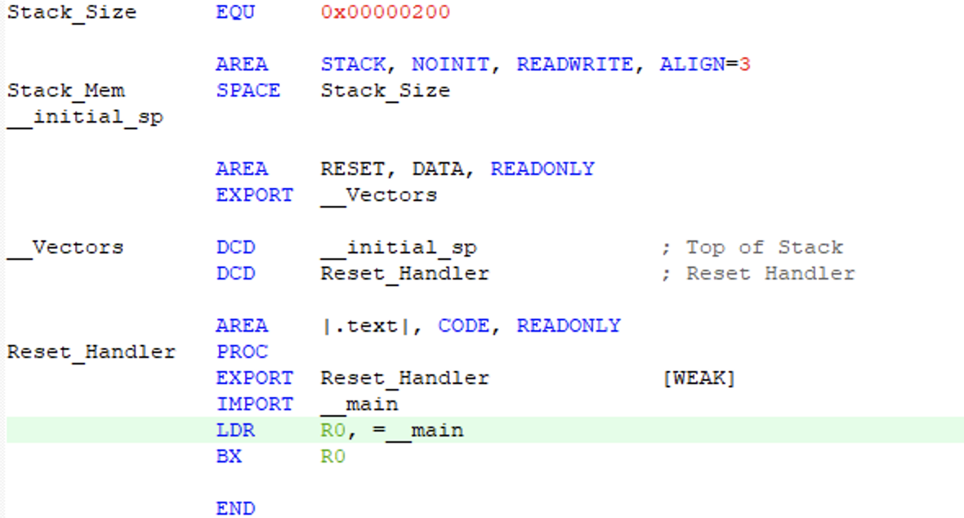
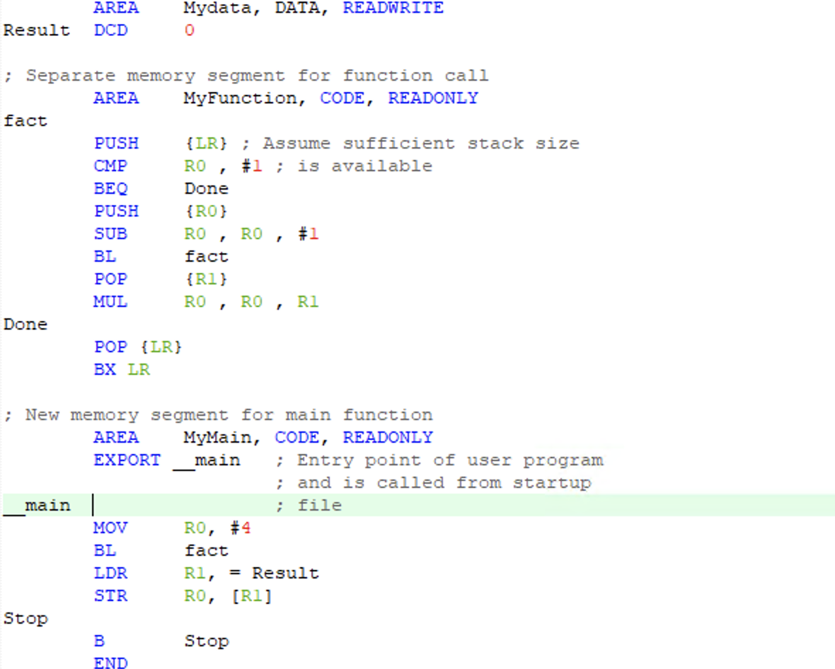
Recursive Calls
C/C++ Code:
unsigned long Fact ( unsigned long n) {
if(n <=1) return 1;
return n * fact(n – 1);
}
int main( ) {
int result = fact(4);
}

Slide 16
ARM Procedure Call Standard (APCS)
long long int ret_val = function( arg0, arg1, arg2, arg3, arg4)
What a caller function has to do:
Memory address | Memory contents
...
SP + 16 | Argument 8
SP + 12 | Argument 7
SP + 8 | Argument 6
SP + 4 | Argument 5
SP (R13) | Argument 4
Register | Register Contents
R3 | Argument 3
R2 | Argument 2
R1 | Argument 1
R0 | Argument 0
What a callee function has to do:
Memory address | Memory contents
SP - 4 | LR (R14)
SP - 8 | R12
SP - 12 | R11
 | ...
SP - 40 | R4
Register | Register Contents
R1 | Return value (if long long int or double)
R0 | Return value

Slide 17
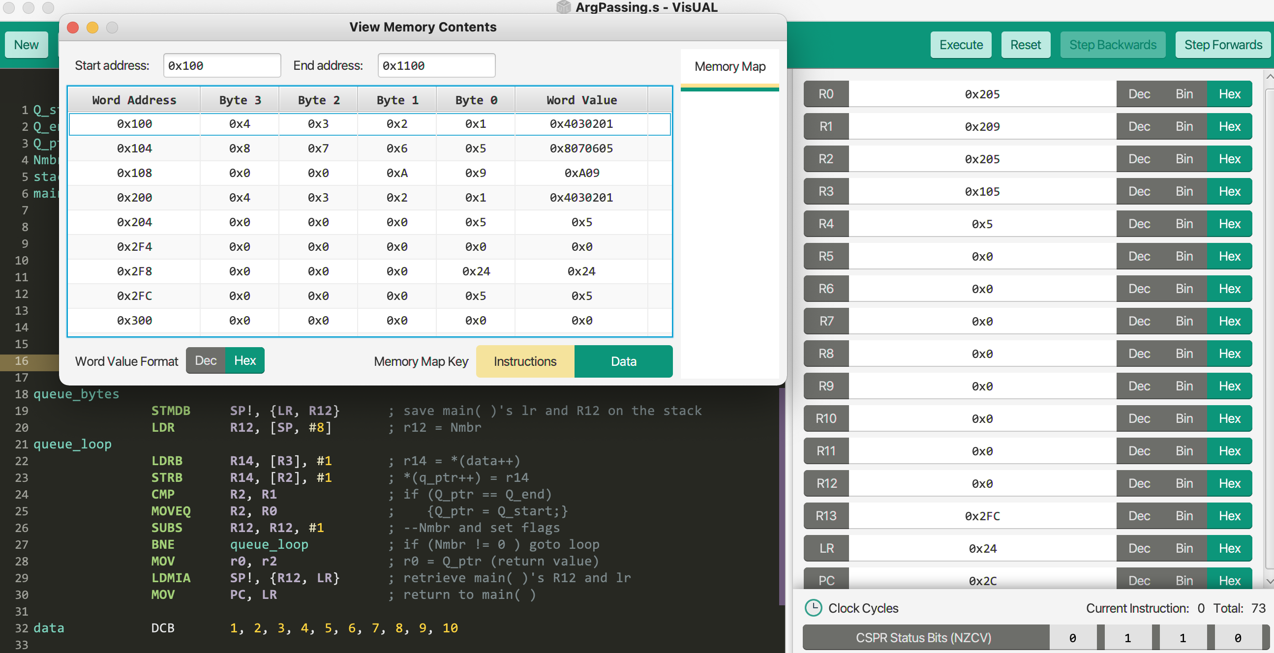
Argument Passing Example
C/C++ code:
char *queue_bytes (
char *Q_start, // Queue buffer start address
char *Q_end, // Queue buffer end address
char *Q_ptr, // Current queue pointer position
char *data, // Data to insert into the queue
unsigned int Nmbr ) // #bytes to insert
{
do {
*(Q_ptr++) = *(data++);
if ( Q_ptr == Q_end )
Q_ptr = Q_start;
} while ( --Nmbr );
return Q_ptr;
}
int main( ) {
char* cur
= queue_bytes( (char *)0x200, (char *)0x209, (char *)0x200, data,
5 );
}
ARM code:
Q_start EQU 0x200
Q_end. EQU 0x209
Q_ptr EQU 0x200
Nmbr EQU 5
stack EQU 0x300
main
LDR SP, =stack
LDR R0, =Q_start
LDR R1, =Q_end
LDR R2, =Q_ptr
LDR R3, =data
LDR R4, =Nmbr
STR R4, [SP, #-4]!
BL queue_bytes
END
queue_bytes
STMDB SP!, {LR, R12} ; save main( )'s lr and R12 on the stack
LDR R12, [SP, #8] ; r12 = Nmbr (because queue_bytes use r12)
queue_loop
LDRB R14, [R3], #1 ; r14 = *(data++)
STRB R14, [R2], #1 ; *(q_ptr++) = r14
CMP R2, R1 ; if (Q_ptr == Q_end)
MOVEQ R2, R0 ; {Q_ptr = Q_start;}
SUBS R12, R12, #1 ; --Nmbr and set flags
BNE queue_loop ; if (Nmbr != 0 ) goto loop
MOV r0, r2 ; r0 = Q_ptr (return value)
LDMIA SP!, {R12, LR} ; retrieve main( )'s R12 and lr
MOV PC, LR ; return to main( )
data DCB 1, 2, 3, 4, 5, 6, 7, 8, 9, 10

Slide 18
IT: If Then Conditional Instruction Block
Instructions | Descriptions | Encoding | Example
IT{x{y{z}} cond | where x, y, and z can be either T (THEN) or E (Else) | 16 bits | ITTT LT ADDLT R2, R0, R1 ; 1st MULLT R3, R2, R0 ; 2nd ASRLT R3, R3, #1 ; 3rd
 |  |  | ITTEE LT ADDLT R2, R0, R1; 1st MULLT R3, R2, R0; 2nd SUBGE R2, R0, R1; 3rd ASRGE R3, R3, #1; 4th
Merits:
Increasing code density
Affecting none of the flags
Generating no exception
C/C++ Code:
if (R0 > R1) {
if (R1 > R2) {
if (R2 > R3) {
R4 = 0x123;
}
}
}
ARM Code:
CMP R0, R1
ITTT GT,
SUBSGT R5, R1, R2
SUBSGT R5, R2, R3
MOVGT R4, #0x123
S overwrites the original condition

Slide 19
MSR and MRS
Instructions | Descriptions | Privileged | Examples
MRS{ond} Rd, spec_reg | Moves the data from a special register to an Rd | Yes except APSR | MRS R0, APSR LSR R0, R0, #26 ; Store NZCVQ in R0[4:0]
MSR{cond} spec_reg Rn | Moves the data from an Rn to a special register | Yes except APSR | LDR R0, =__initial_user_sp MSR PSP, R0 MOVS R0, #3 ;Set SPSEL bit 1 ;Set nPriv bit 0 MSR CONTROL, R0
We will use the final project. ☺

Slide 20
Summary
Which pair of branch instructions are used to implement a function call and return?
How to implement a function return in VisUAL that does not support BX.
Why doesn’t unsigned conditional branches use N and V flags?
Why does an recursion example on p14 push R0 but pop R1?
What if all arguments to be passed are long long int?
Why is the IT instruction useful?
Why do MSR and MRS require the privileged mode?

